Slide 1







Network Design For Automobile Industry
19CSE301
Computer Networking

Slide 2


OverView
In this Network, we will provide a quick overview of network design for the automobile sector, as well as the components required to build and implement a network.

Slide 3
Objective
The main objective of the proposed network is to update the existing network and also enhance its capabilities and increase the flexibility of the network

Slide 4

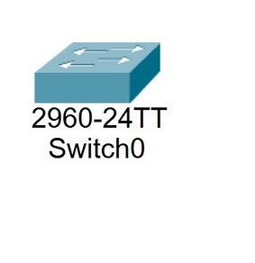
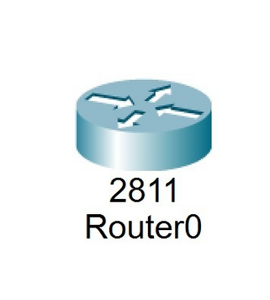
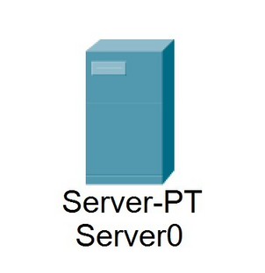

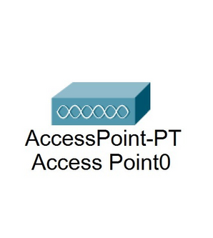
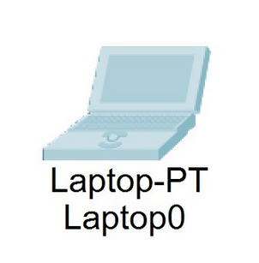

Technology Used

Slide 5

Topology
•We use both physical and logical topology
•We use star topology as a network structure
Star Topology
•Router type 2811 as a central hub and every node is connected to the router by using copper straight-through wire.
•Limited failure in network.
•Less Expensive.
•It is easy to install

Slide 6


Connections
Wired Connection
telephone networks, cable television or internet access, and fiber-optic communication
Wireless Connection
ell phone networks, wireless local area networks (WLANs), wireless sensor networks, satellite communication networks

Slide 7

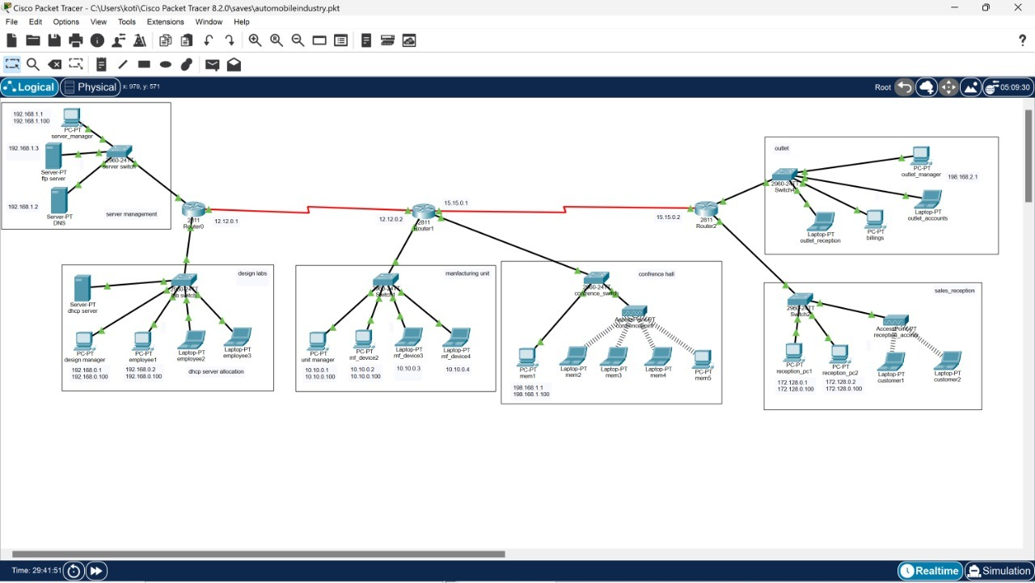
Network Design

Slide 8


Conclusion
We Learned how to create anetwork for an organization.
We Learned how to work with CISCO packet tracer.
We cam to know how FTP,DNS,DHCP Servers work.

Slide 9
Thank You

